Slide 1
Markdown for collaborative authoring
DocOps

Slide 2
Sound familiar?
You need to produce customer facing content, but hate desktop publishing?
You spend way too much time fussing with how a document looks?
You lose track of the latest version of a document- especially when you work on it with other folks?
You find it hard to keep documents in sync when they are supposed to contain the same content?
You spend too much time trying to manage writing or editing permissions on privileged content?

Slide 3

What if…...
You authored content in Markdown, and managed content in GitLab?
You could focus on your ideas and leave the styling and delivery to a downstream process.

Slide 4

The authoring challenge….
Desktop publishing in Google Docs
An author wastes about 30% of their time on appearance and formatting for corporate style
This effort adds no value to the content

Slide 5

The reuse challenge……
Reuse
Large monolithic files are inherently not very reusable
Markdown files can contain very discrete chunks of topic content that are reusable

Slide 6

The control challenge….
We have all run into problems controlling content in GSuites:
Keeping documents in sync when they are supposed to be the same
Clone and own- someone grabs your document and lets part of it get out of date when it can’t inherit changes

Slide 7
What is Markdown?
Markdown is a lightweight markup language for creating formatted text using a plain-text editor.
Markdown support basic elements like headings, lists and tables.
Markdown is rendered by a browser.
## Behavox suggestions:
* Target only Front Office employee ME Groups;
* Consider excluding Front Office Controls, Business Management, Admin or any other Groups that do not engage in trading activity;
* Use of additional CRX Scenarios. This includes:
* Insider Dealing;
* Insider Dealing Activity;
* Front Running;
* Wash Trades;
* Parking Equities;
* Parking Securities;
* Gifts & Entertainment.

Slide 8
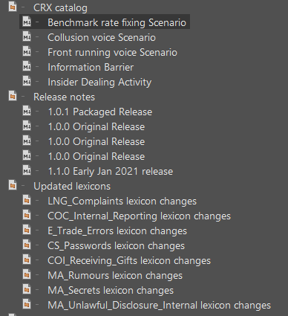
Ok, I wrote in markdown, now what?
Markdown files play well with the structured authoring environment that DocOps uses to produce Help Center.
We can map markdown files to create a structure or hierarchy of topics to form deliverables.
Markdown can share a map with our regular content files too if you want to create a hybrid deliverable.

Slide 9
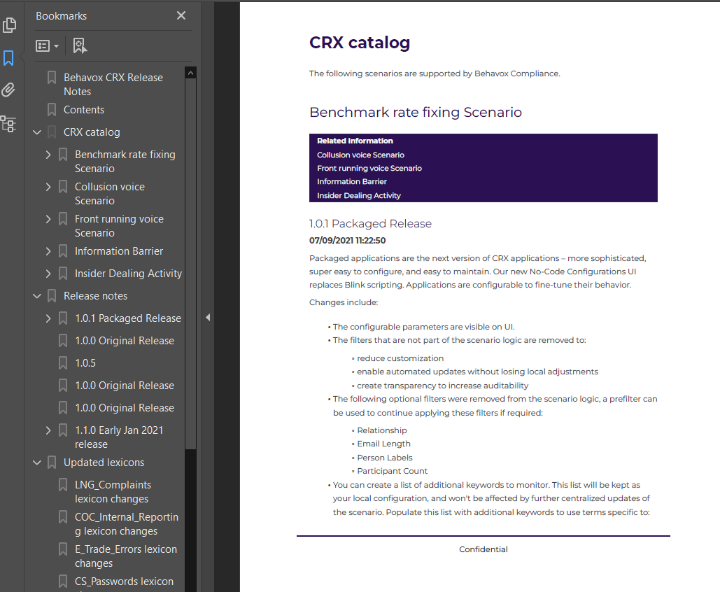
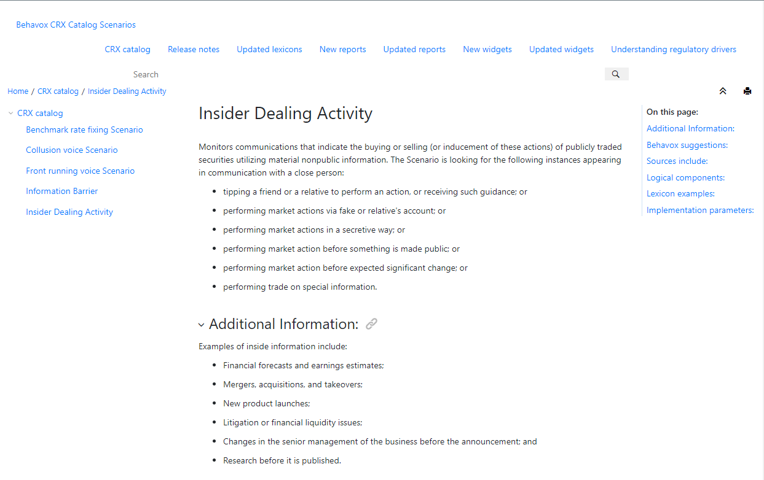
Transforming markdown
Once content is mapped, our transforms can produce on-brand PDF, Help Center topics, or WebHelp off product.

Slide 10
Immediate applications…
Where can we use collaborative authoring for Markdown today?
Is there content that we need to put in front of customers that seems onerous to produce as a branded deliverable?
Is there content we could make available earlier in the customer journey with little additional cost?
We could deliver ML docs both on-product in HTML, and as standalone pdf.
We currently deliver markdown on-product for scenario change docs. We could provide standalone pdf of this content.

Slide 11

Looking to the future…..
What if automation ran every night to:
extract flagged markdown from the repo
build the doc
publish it to a customer-facing portal
…. ensuring that content was up-to-date everyday, automagically?

